Slide 1
Project Part:
Reliable Construction Data Storage using Blockchain Technology
[Note]: This version of the PPT may NOT be the final one for the presentation.

Slide 2
Overview
Reliable construction data storage using blockchain technology
Aim: Create a reliable database for construction data by leveraging blockchain technology (in Hyperledger Fabric Platform).
Objectives:
Grasp the core algorithm framework and configuration files for distributed ledger management in Hyperledger Fabric.
Gain proficiency in writing and deploying smart contracts in Hyperledger Fabric.
Utilize databases like Hyperledger Explorer and CouchDB for frontend data demonstrations.
Deliverables: A project report
Requirements: Introduction, methodology, experiments, and case demonstration
Resources:
Hyperledger fabric tutorials (v1.4): https://hyperledger-fabric.readthedocs.io/en/release-1.4/build_network.html
Hyperledger fabric source code: https://github.com/hyperledger/fabric

Slide 3
Contents
Why blockchain
Introduction of Hyperledger fabric
Key steps of your project
Example

Slide 4
1. Why blockchain
Why blockchain
Contract management
Payment delay (J. Wang et al., 2017)
High transaction cost (S. Ahmadisheykhsarmast et al., 2018)
Insecure payment (Z. Dakhli et al., 2019)
Low digitalization (J. Mason et al., 2018)
Supply chain management
Poor transparency of process (A. Sivula et al., 2018)
Opportunistic behaviors in cooperation(X. Qian et al., 2020)
Trust crisis between partners (C. Sun & M. Wang, 2020)

Slide 5
1. Why blockchain
Why blockchain
Information management
Unreliability (G.M. Di Giuda et al., 2020)
Privacy data leakage (Z. ˇ Turk & R. Klinc, 2017)
Poor data traceability (Z. Zhang et al., 2020)
Inefficient information sharing (G. Pattini et al., 2020)
Low digitalization (J. Li et al., 2020)

Slide 6
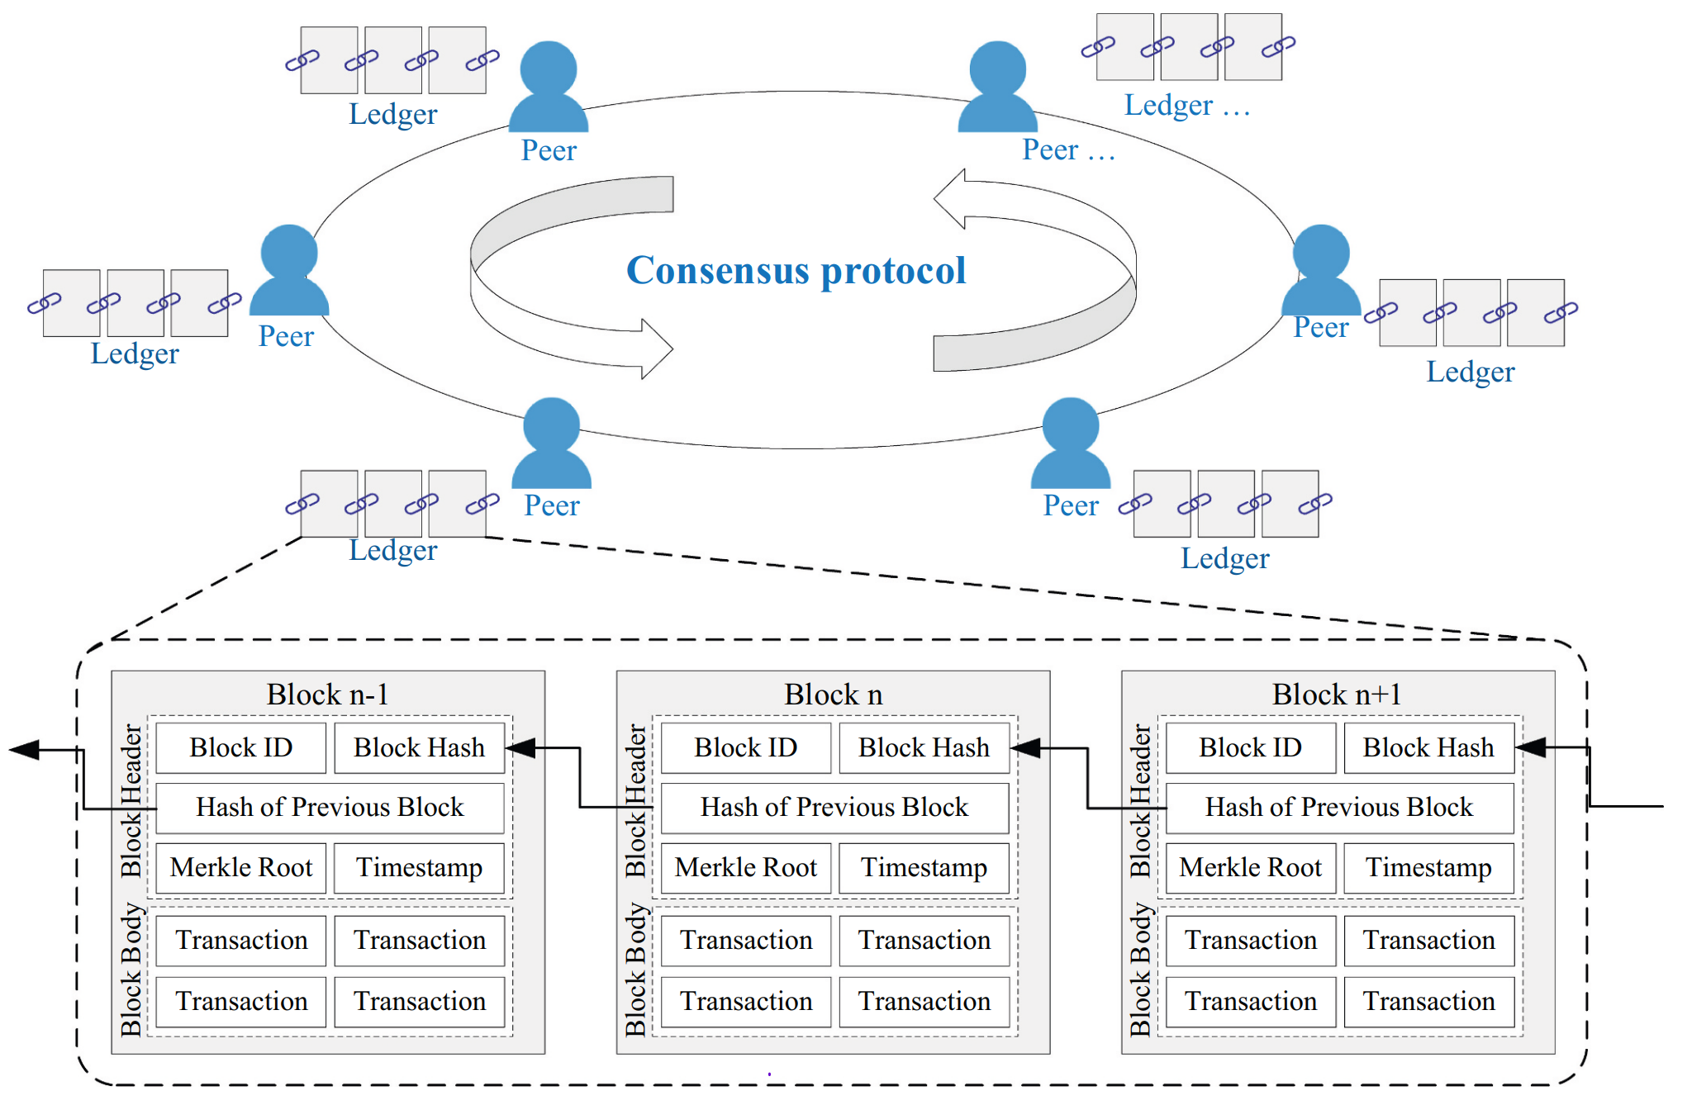
1. Why blockchain
What is blockchain?
Definition: blockchain is a decentralized digital ledger that records transactions across multiple computers (Satoshi Nakamoto, 2008)
Block Structure: Block ID, Block Hash, Previous Hash, Timestamp, Data…
Cryptography
Consensus mechanism
source: Xu, Y.Q., Tao, X.Y., Das, M., Kwok H.H.L, Liu H., Wang G.B., Cheng J.C.P. 2023. Suitability analysis of consensus protocols for blockchain-based applications in the construction industry. Automation in Construction 145, 104638.
(Xu et al., 2023)

Slide 7
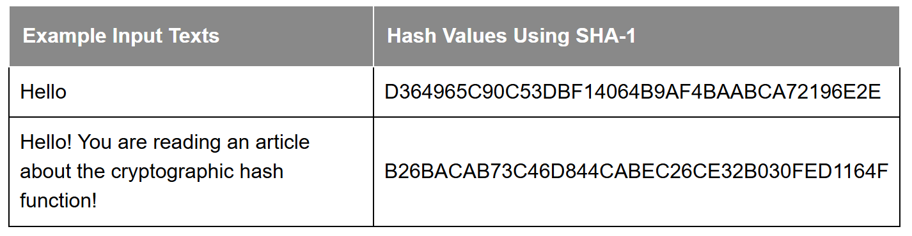
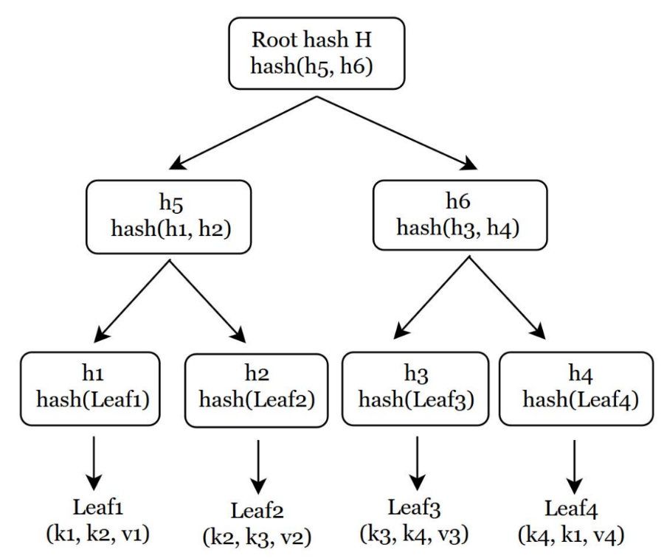
1. Why blockchain
Cryptography
Hash function: a mathematical function that takes an input (or "message") and produces a fixed-size string of characters, which is typically a sequence of alphanumeric characters.
One-way
Collision-free
Mertle Tree (Hash Tree): a hierarchical data structure that is used to efficiently verify the integrity and consistency of data in blockchain
source: https://sectigostore.com/blog/hash-function-in-cryptography-how-does-it-work/
Souce: Naila Bushra, Naresh Adhikari , Mahalingam Ramkumar. Secure Queryable Dynamic Graphs using Blockchain. 2019 First IEEE International Conference on Trust, Privacy and Security in Intelligent Systems and Applications (TPS-ISA)

Slide 8
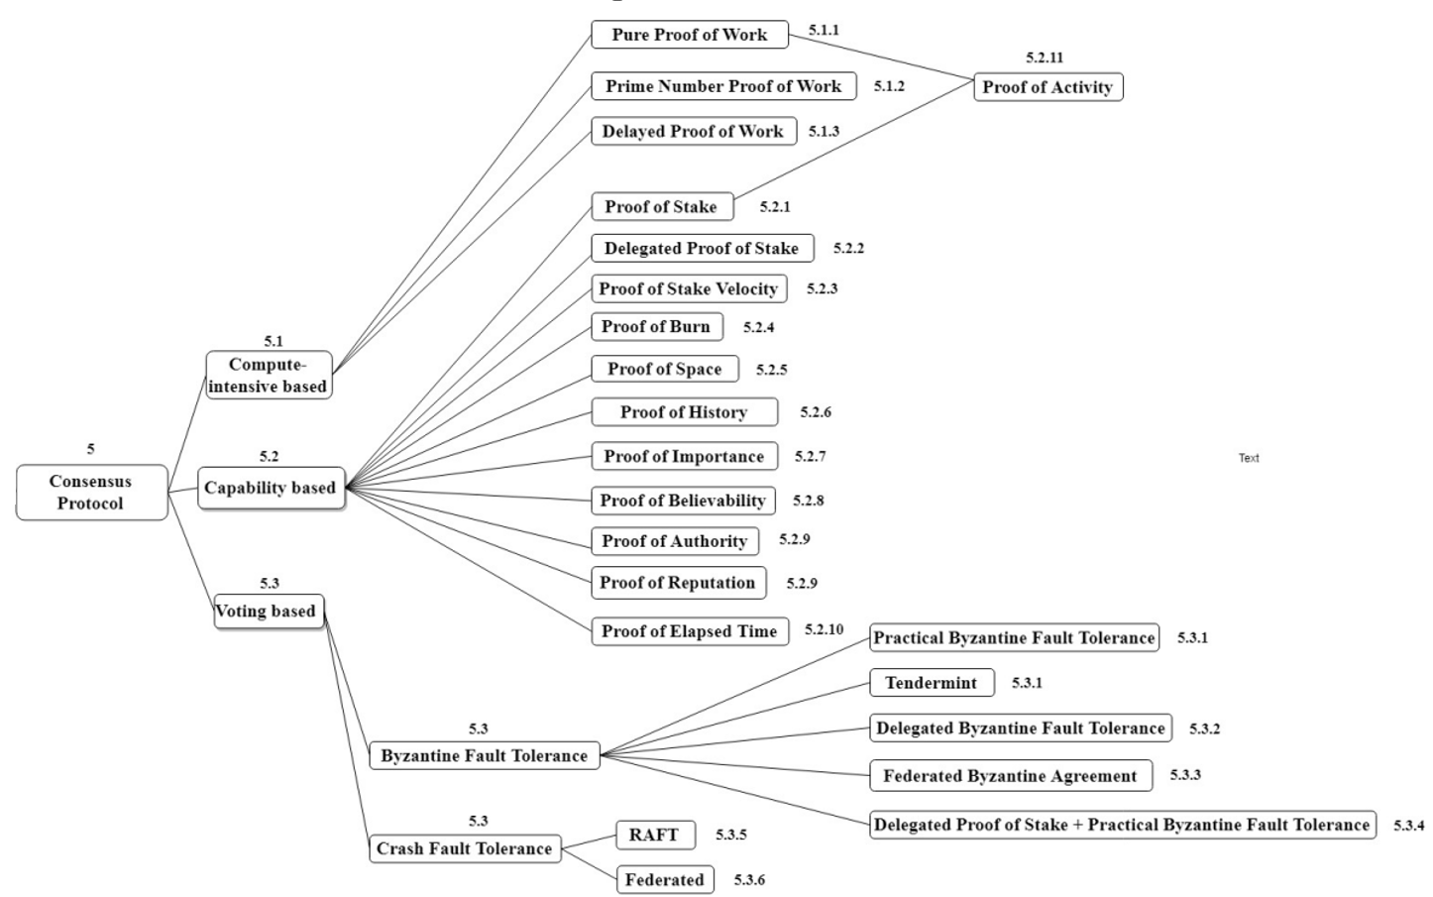
1. Why blockchain
Consensus mechanism
Definition: the mechanism by which participants in a distributed system reach an agreement or consensus in blockchain
Classification(Ismail et al., 2019)
Each consensus mechanism has its own set of rules
Souce: Ismail L., Materwala H., 2019. A Review of Blockchain Architecture and Consensus Protocols: Use Cases, Challenges, and Solutions. Symmetry 11, 1198.

Slide 9
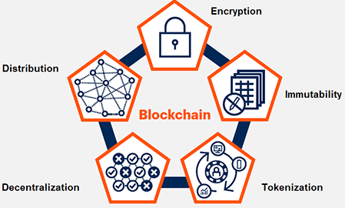
1. Why blockchain
Properties of blockchain
Security: all records are individually encrypted
Transparency (public chain): all participants on the network have access to all transaction records
Immutability: any validated records are irreversible and cannot be changed
Distributed: all trusted participants have a copy of the ledger
Consensus: all network participants agree to the validity of each of the records
Automation (smart contract): auto execution of smart contracts
Source: https://www.isme.in/blockchain-technology-securing-everything-critical-prof-rajaram-sastry/
Source: https://weteachblockchain.org/courses/blockchain-101/01/properties-of-a-blockchain
Source: https://www.analyticsvidhya.com/blog/2022/09/blockchain-technology-and-its-types/

Slide 10
1. Why blockchain?
Categories & development of blockchain
Categories (according to ownership features and access management) (Wang et al., 2019)
public (permissionless)
private (for permissioned nodes)
consortium (mix)
Development (Yang et al, 2023)
1.0: cryptocurrency - Bitcoin
2.0: smart contracts - Ethereum
3.0: industry applications - Hyperledger Fabric
Source: Wang, Y., Singgih, M., Wang, J., Rit, M., 2019. Making sense of blockchain technology: How will it transform supply chains? Int. J. Prod. Econ. 211, 221–236.
Source: Z. Yang, Z. Chen, Y.M. Zhu, X.D. Li, 2023. Blockchain technology in building environmental sustainability: A systematic literature review and future perspectives. Building and environment 245:11097

Slide 11
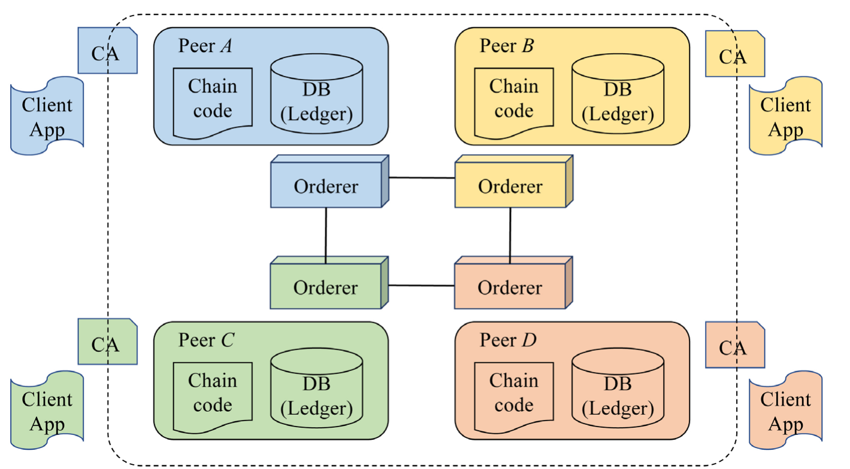
2. Hyperledger Fabric
Conceptual structure of Hyperledger fabric
Hyperledger fabric: an open-source enterprise-grade permissioned distributed ledger technology (DLT) platform
the first to support smart contracts authored in general-purpose programming languages (go, java, node.js)
highly modular and configurable architecture
support for pluggable consensus protocols
Source: https://hyperledger-fabric.readthedocs.io/en/release-1.4/whatis.html
Source: Agoda-Koussema, Ragouguelaba & Haga, Hirohide. (2021). Highly Secure Residents Life Event Management System Based on Blockchain by Hyperledger Fabric. Journal of Computer and Communications. 09. 38-55. 10.4236/jcc.2021.99003.

Slide 12
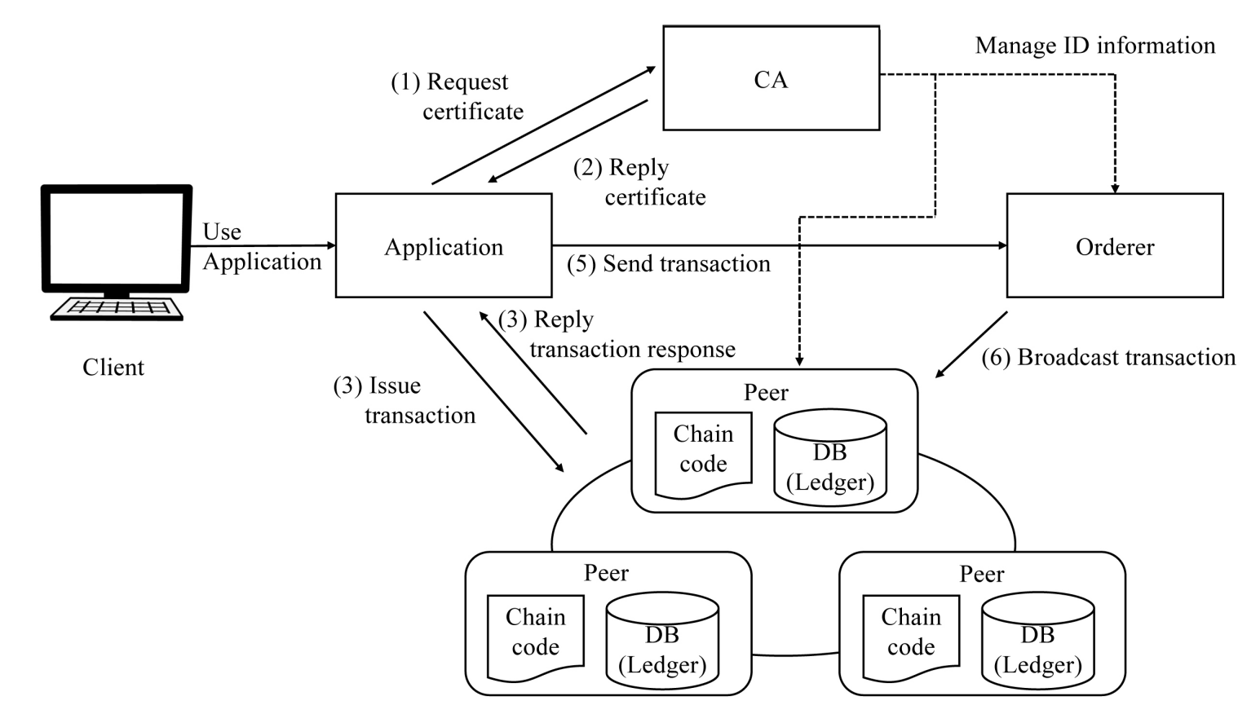
2. Hyperledger Fabric
Hyperledger fabric workflow
Orderer: transaction ordering and packaging
Peer: maintain the ledger and execute chaincode (smart contracts)
Source: Agoda-Koussema, Ragouguelaba & Haga, Hirohide. (2021). Highly Secure Residents Life Event Management System Based on Blockchain by Hyperledger Fabric. Journal of Computer and Communications. 09. 38-55. 10.4236/jcc.2021.99003.

Slide 13
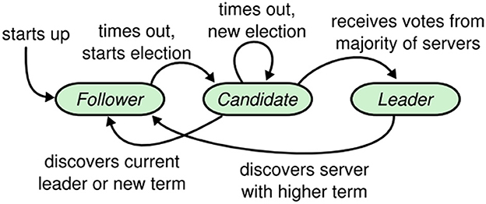
2. Hyperledger Fabric
Default consensus mechanism: RAFT
Three roles (for orderers)
follower
candidate
leader
Three key steps
leader election
log replication
transaction execution
Source: Ongaro & Ousterhout, 2014, In Search of an Understandable Consensus Algorithm. Stanford University
Source: Jabbar S, Abideen ZU, Khalid S, Ahmad A, Raza U and Akram S (2023) Enhancing computational scalability in Blockchain by leveraging improvement in consensus algorithm. Front. Comput. Sci. 5:1304590

Slide 14

2. Hyperledger Fabric
Default consensus mechanism: RAFT
https://thesecretlivesofdata.com/raft/

Slide 15
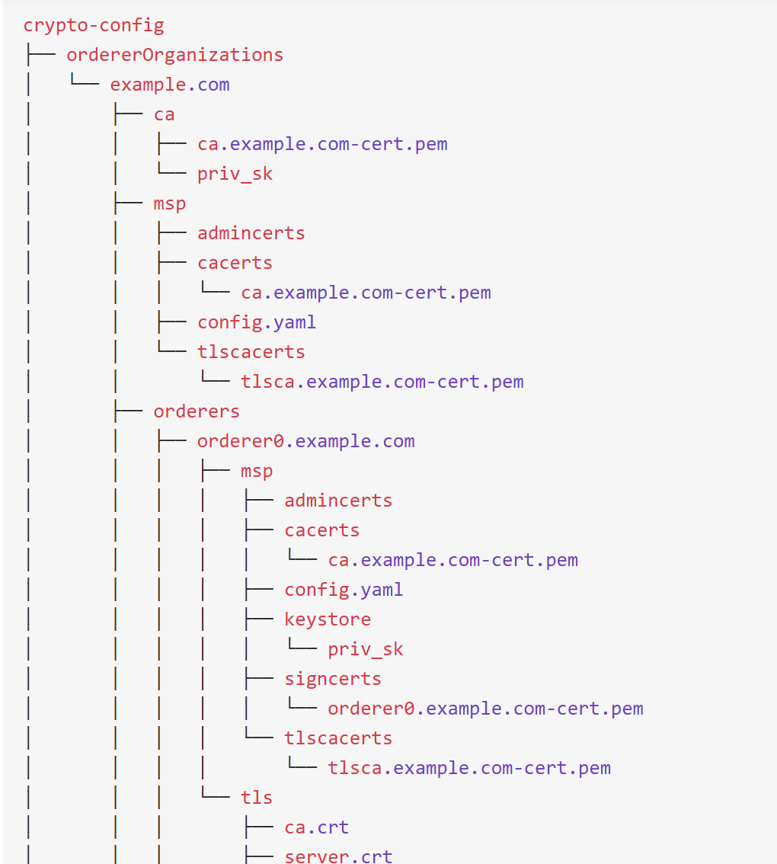
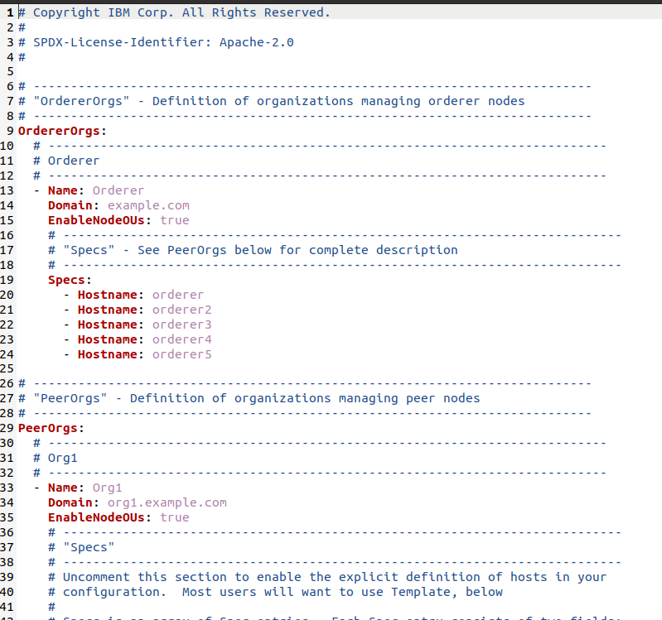

2. Hyperledger Fabric
Key configure files (for your first-network building - through Docker)
crypto-config.yaml: organization information (to generate certificates)

Slide 16
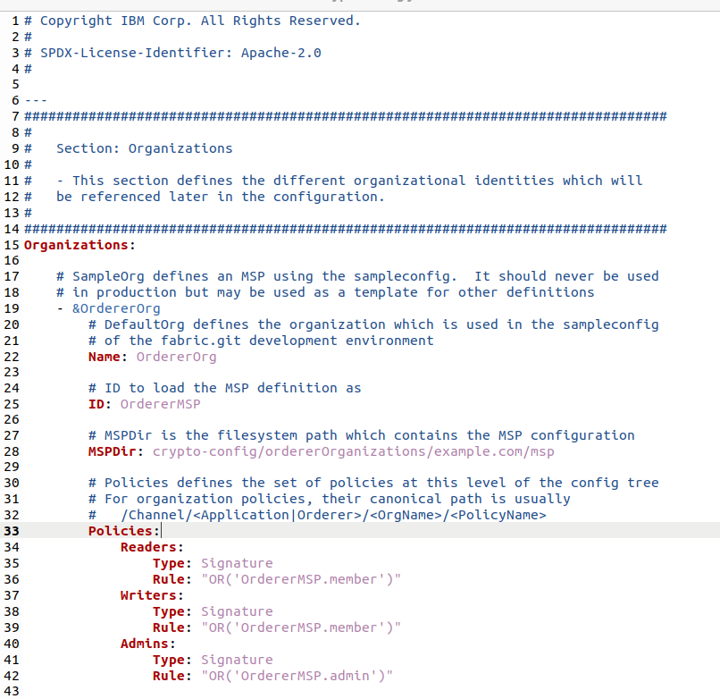
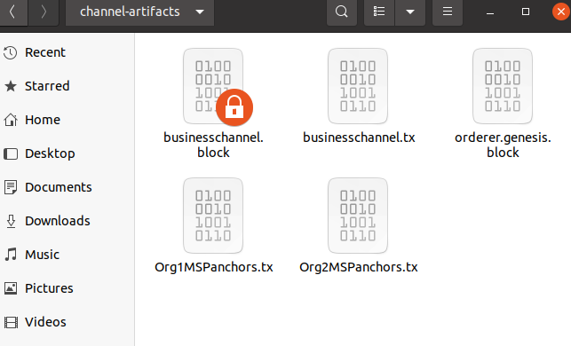
2. Hyperledger Fabric
Key configure files (for your first-network building – through Docker)
configtx.yaml: organization information (for genesis block)

Slide 17
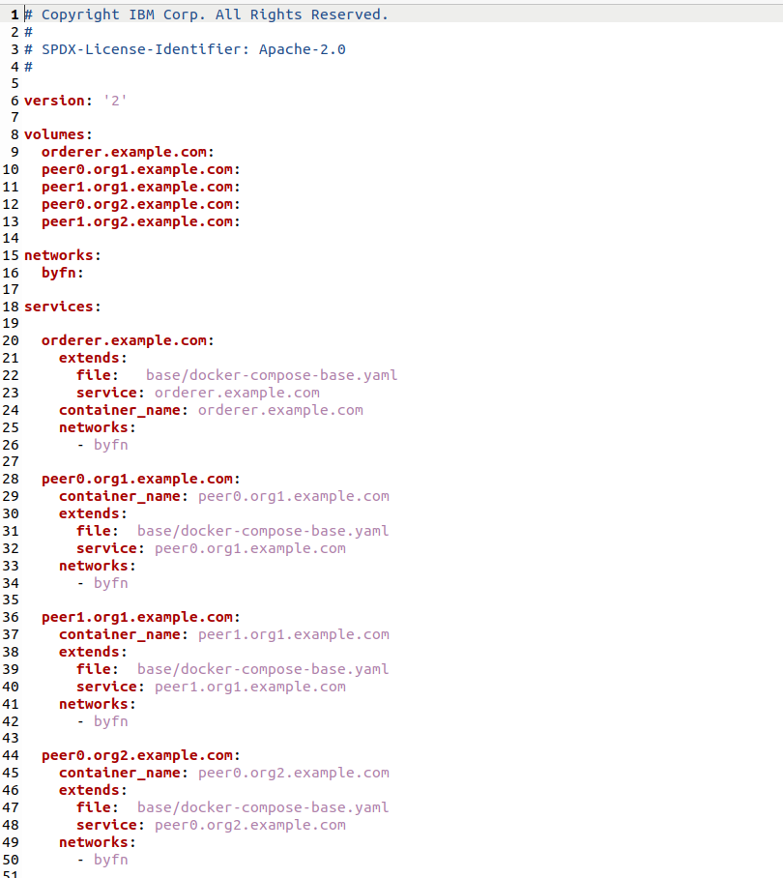
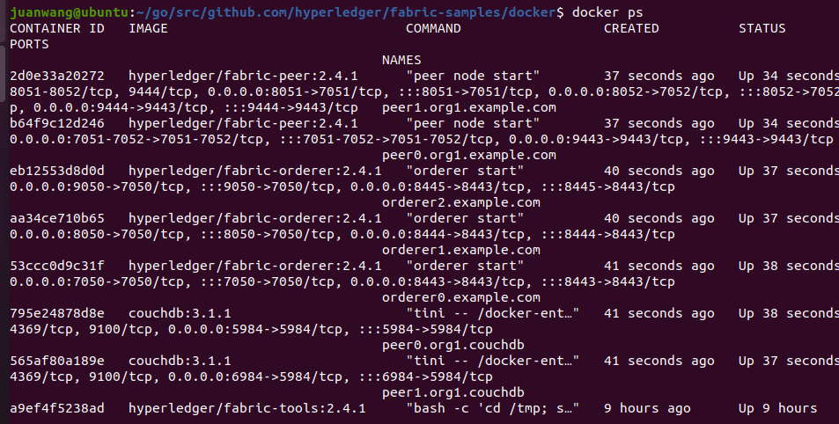
2. Hyperledger Fabric
Key configure files (for your first-network building – through Docker)
docker-compose.yaml: to start your docker containers (network up)

Slide 18
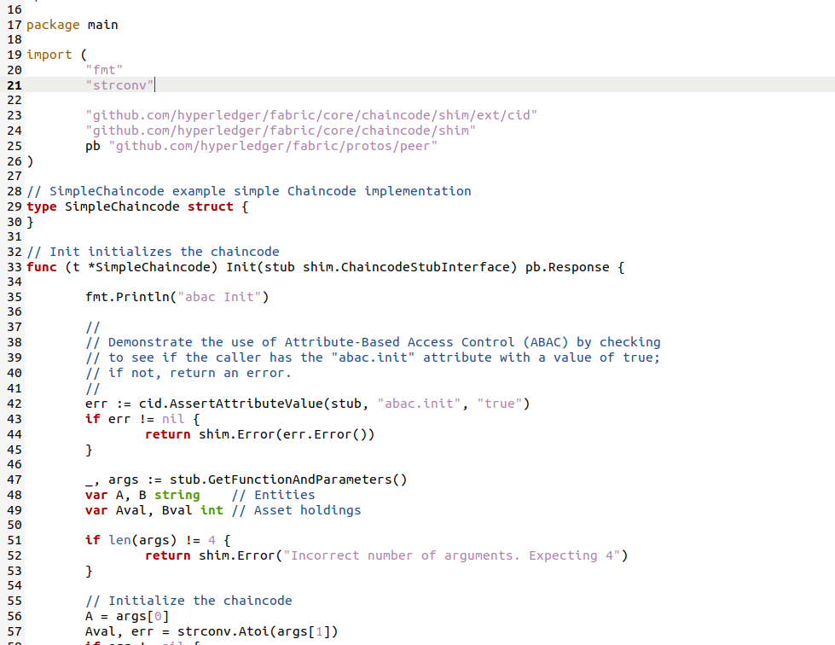
2. Hyperledger Fabric
Chaincode (smart contract)
Self-execute code, written in Go, node.js, or Java
Runs in a secured Docker container isolated from the endorsing peer process
Key functions: Init(), query(), invoke()
Init(): initialization operations when the chaincode is instantiated
query(): read-only queries to retrieve chaincode state or data.
invoke(): code for processing transaction logic, such as transaction validation, state update, event triggering, etc.

Slide 19
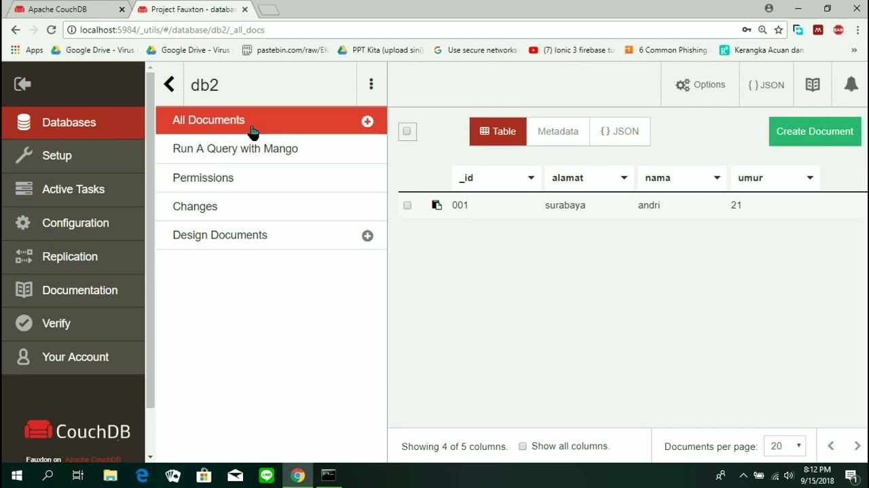
2. Hyperledger Fabric
State database with Hyperledger fabric
CouchDB
NoSQL (key-value maps)
JSON format
Source: https://www.tutorialkart.com/couchdb-tutorial/#gsc.tab=0

Slide 20
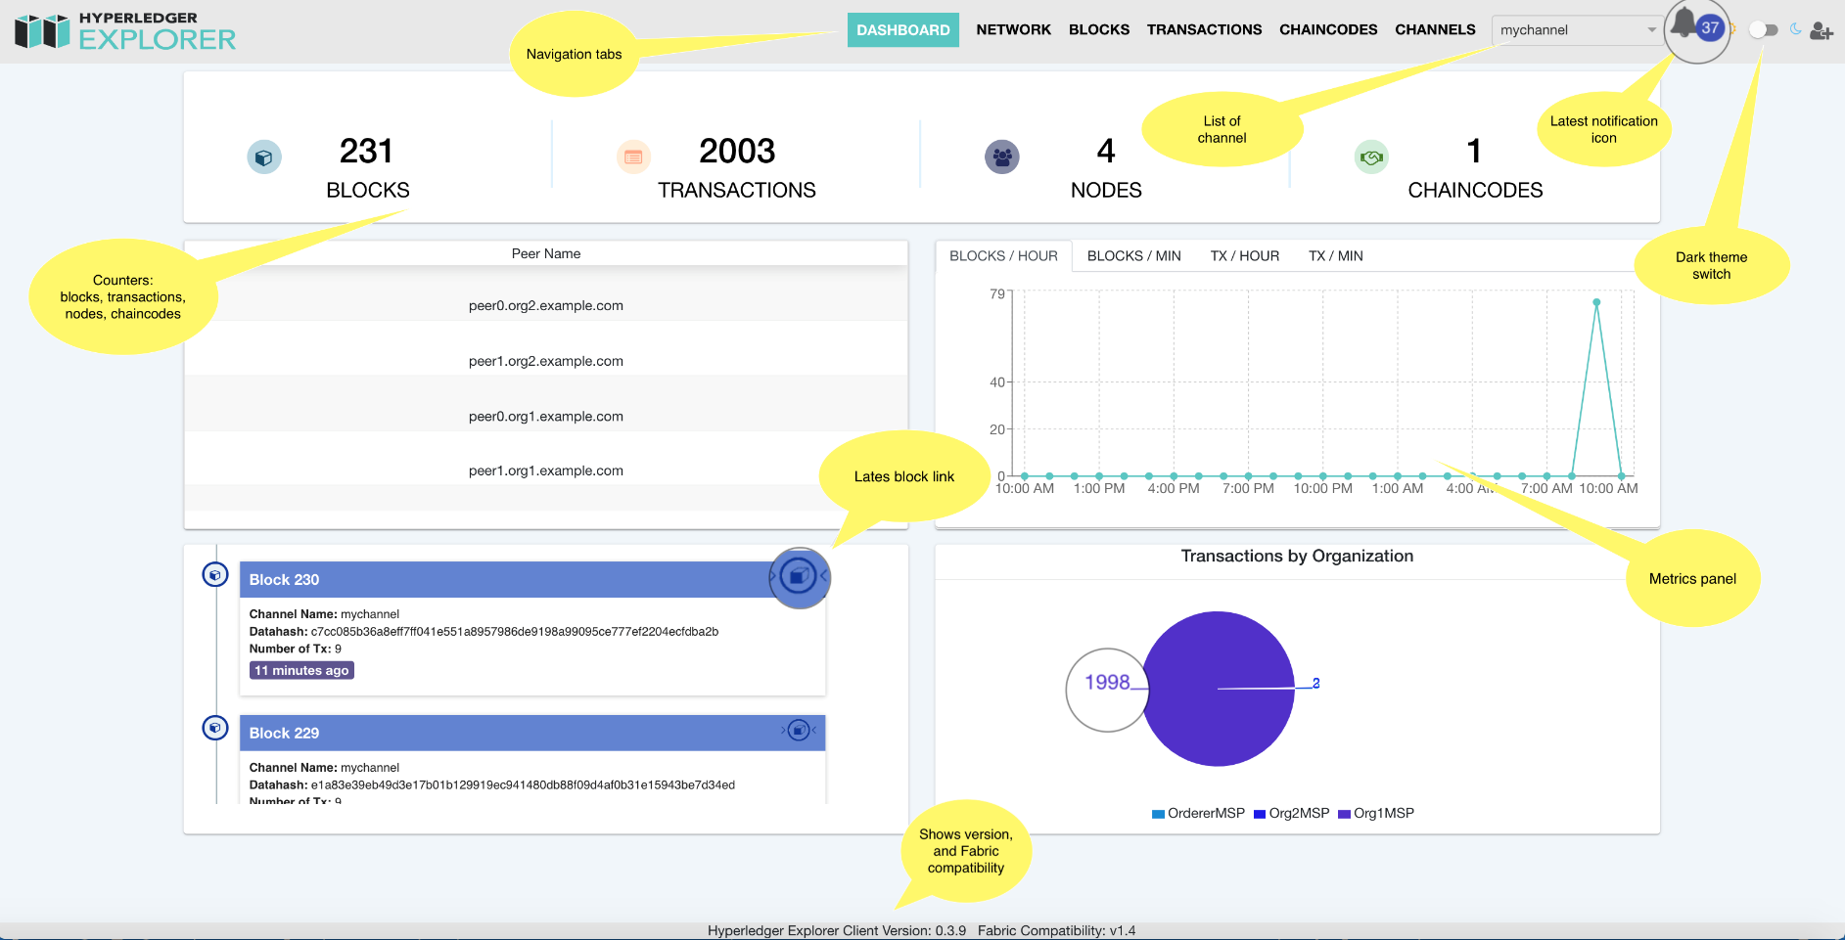
2. Hyperledger Fabric
State database with Hyperledger fabric
Hyperledger explorer
visualizing blockchain operations for HF
Source: https://blockchain-explorer.readthedocs.io/en/main/presentation/

Slide 21
3. Key steps of your project
Step 1: Scenario selection
Scenario description
Which specific scenario that you want to discuss?
How many roles / stakeholders in your selected scenario? (e.g., government, workers, managers, suppliers…)
What is the affiliation relationship between these stakeholders? (e.g., organization & member)
What is the interaction rules between these stakeholders? (e.g., transaction rules)
How to qualify these interactions (and describe them by codes in smart contract later) ?

Slide 22
3. Key steps of your project
Step 1I: Environment preparation
Software Environment
Ubuntu 20.04 (Linux)
Go
Docker
Docker-compose
…

Slide 23
3. Key steps of your project
Step 1II: Modify configuration files
Modify the relevant configuration files according to your scenario
crypto-config.yaml
configtx.yaml
docker-compose.yaml files (/orderer.yaml, peer.yaml, docker-compose_cli.yaml)
docker-compose_couchdb.yaml (if couchdb)
networkconnnection.json, docker-compose_explorer.yaml (if Hyperledger explorer)
…

Slide 24
3. Key steps of your project
Step 1V: Write smart contract
Smart contract
Code for the interaction rules between stakeholders in your selected scenarios
Language: go, java, node.js (follow your preference)

Slide 25
3. Key steps of your project
Step V: Start your blockchain network
Key processes of network-up:
Generate certificates
Generate genesis block
Create channel
Update by anchor peers
Start docker containers
Deploy your chaincode
…

Slide 26
3. Key steps of your project
Step VI: Test & analysis
Test and analysis:
Design tests to validate your blockchain project
Demonstrate your results
Step VII: a project report
Introduction/background, methodology, experiments, and case demonstration

Slide 27
4. Example
A blockchain-enabled payment system for construction health and safety management (example)
Step I: Scenario selection
Background: construction industry is one of the most dangerous industries in the world, and the Occupational Health and Safety is of great significance. Health factors may involve air pollution, noise pollution, waste pollution…
Aim: to improve OHS level, the ones with better performance in construction OHS would receive more profits
Chaincode is to realize the automation of this differentiated payment where bad violations will be detected; blockchain is to record data

Slide 28
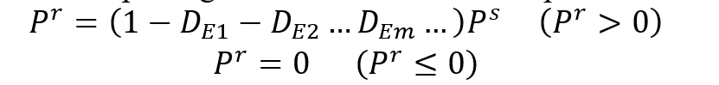
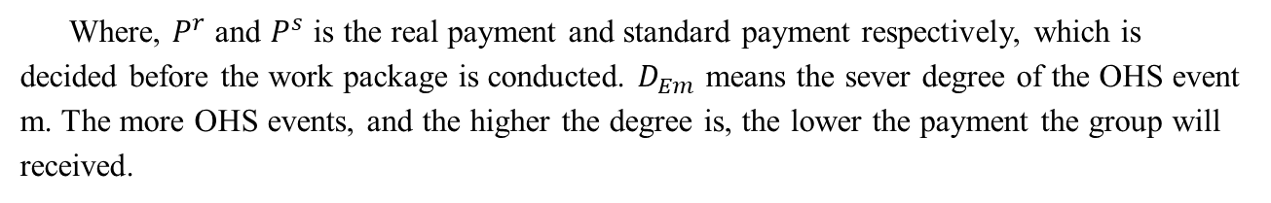
4. Example
A blockchain-enabled payment system for construction health and safety management (example)
Step I: Scenario selection
Roles & relationships: workers (transfer receivers) and the company (transfer sender)
Interaction rules (payment rule)
Degree | Degree I | Degree II | Degree III | Degree VI | Degree V | ＞Degree V
Grade decrease rate | 0.1 | 0.2 | 0.3 | 0.4 | 0.5 | 1.0 (no pay)
Where, $P^{r}$ and $P^{s}$ is the real payment and standard payment respectively, which is decided before the work package is conducted. $D_{Em}$ means the sever degree of the OHS event m. The more OHS events, and the higher the degree is, the lower the payment the group will received.

Slide 29
4. Example
A blockchain-enabled payment system for construction health and safety management (example)
Step II: Environment preparation
Ubuntu 20.04
Go 1.18.2
Docker 24.0.5
Docker-compose 1.25.0
…

Slide 30
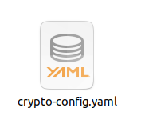
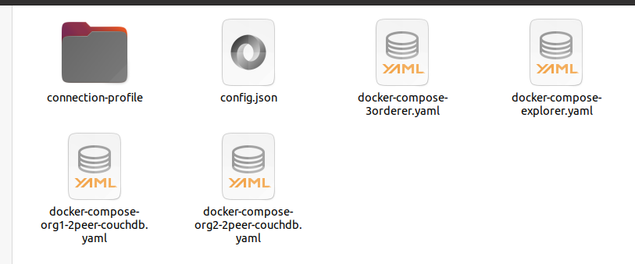

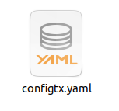
4. Example
A blockchain-enabled payment system for construction health and safety management (example)
Step III: Modify configuration files

Slide 31
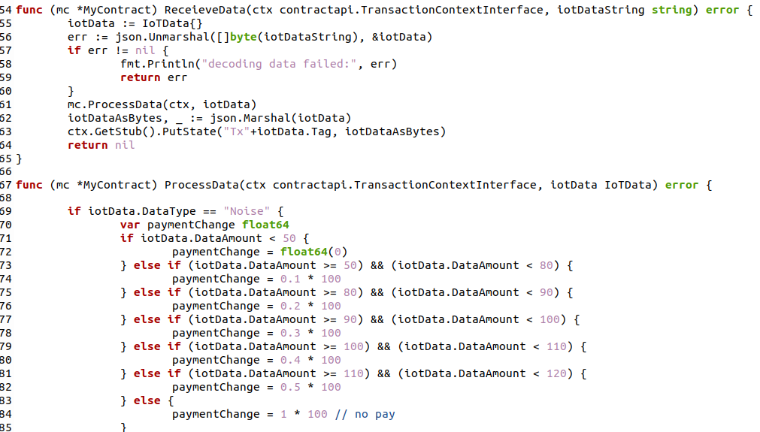
3. Key steps of your project
A blockchain-enabled payment system for construction health and safety management (example)
Step IV: write chaincode (smart contract; Go)

Slide 32
4. Example
A blockchain-enabled payment system for construction health and safety management (example)
Step V: Start your blockchain network
Step VI: Test & analysis
Initial setting
Noise level range (dB) | OHS issue degree
<50 | - (full paid)
(50,80] | Degree I
(80,90] | Degree II
(90,100] | Degree III
(100,110] | Degree VI
(110,120] | Degree V
>120 | - (no pay)
worker id | Noise level | OHS issue degree | Payment decrease rate | Standard payment
1 | 45 | - | 0 | 100
2 | 80 | Degree I | 0.1 | 100
3 | 95 | Degree II | 0.2 | 100
4 | 100 | Degree III | 0.3 | 100
5 | 115 | Degree V | 0.5 | 100

Slide 33
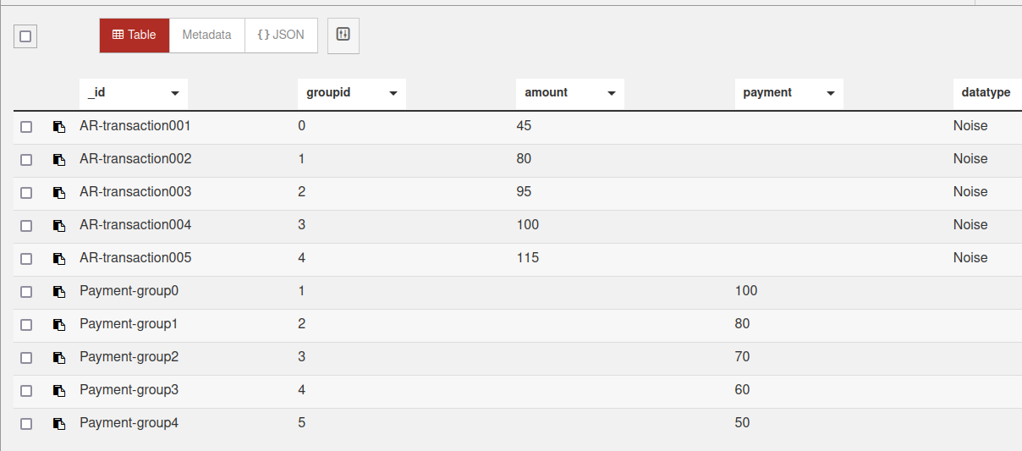
4. Example
A blockchain-enabled payment system for construction health and safety management (example)
Step VI: Test & analysis
Couchdb (payment result)

Slide 34
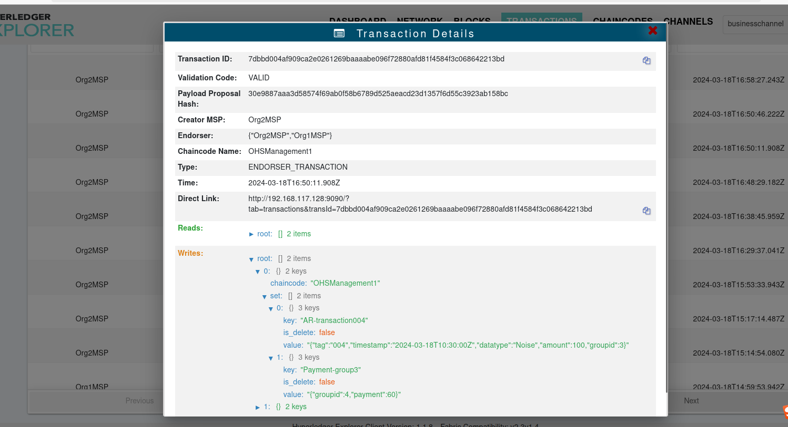
4. Example
A blockchain-enabled payment system for construction health and safety management (example)
Step VI: Test & analysis
Hyperledger exploerer (block detail)

Slide 35
Thanks for your attention!
Juan WANG
juanwang@connect.hku.hk

